Slide 1

Embedded Programming Skill
Amizzuddin Amin

Slide 2
Table of Content
Installation and setup guide

Slide 3
Editor for Embedded programming
There are 3 methods to get Arduino programming work on Microsoft Visual Studio Code.
Arduino extension
Arduino CLI
Platform IO extension
Each of these method have its pros and cons.

Slide 4
Editor for Embedded programming
Arduino IDE extension
Simple and easy to install
Uploading sketch not as fast as Arduino CLI
Arduino CLI
Complicated to install
Fast at uploading sketch
Doesn’t require to install extension
Platform IO extension
Simple and easy to install
Multi-board support

Slide 5
Editor for Embedded programming
This slide we will be covering the installation guide for
Arduino extension
Arduino CLI

Slide 6
Arduino extension
The steps to get Arduino programming to work on Microsoft visual studio code is very simple and straight forward. In my opinion, this method is not as versatile as compared to Arduino CLI. There are a few links on how to get this started and personally I feel the guide is good.
Installation guide
Debugging guide
NOTE: You need to have Arduino IDE installed in your system.

Slide 7
Arduino CLI (Command-Line Interface)
This is my personal favourite as I don’t need to install Arduino IDE. At the same time, there is no need for Arduino extension. This is because libraries can be downloaded via command prompt. I followed the instructions from the following link. Remember the steps required is just like getting C programming install on Visual Studio Code.
Kindly do the Arduino CLI before we can proceed to next step on configuring to work on Visual Studio Code. Do take note that the steps list in this slide are for Windows user.

Slide 8
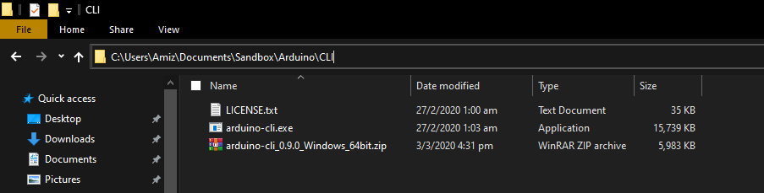
Arduino CLI (Command-Line Interface)
1) Create a folder in your sandbox named “Arduino”.
2) Create another folder name “CLI” within the Arduino folder.
3) Extract the zip file you download earlier here.
You should something like the below picture

Slide 9
Arduino CLI (Command-Line Interface)
4) This is very important step before we can proceed other step. Just like configuring C, we need to add PATH in your USER variables on environment variable. To check if you have successfully add Arduino CLI. Type arduino-cli on command prompt.
IF you CMD does not recognize arduino-cli, you do the following:
Restart cmd and try to type arduino-cli. If the command is still unrecognizable,
Add PATH of Arduino-CLI to your system variable PATH.

Slide 10
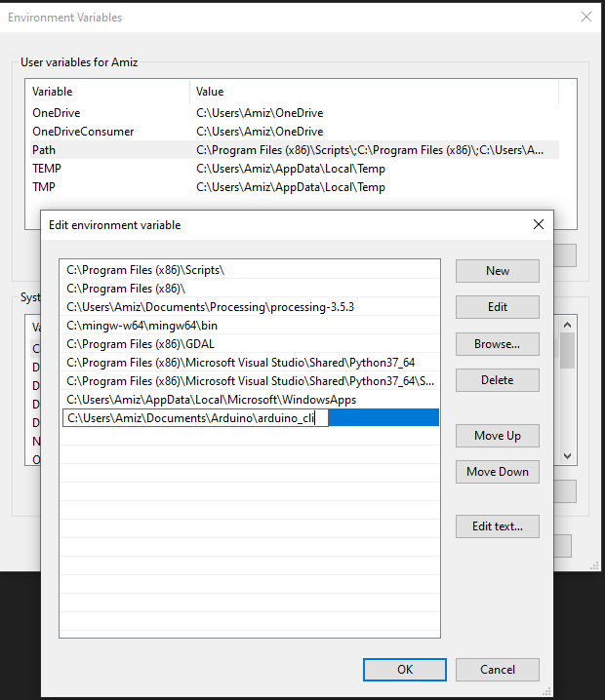
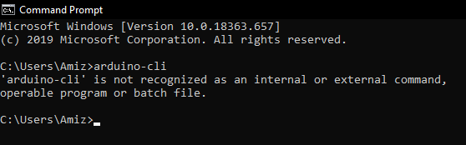
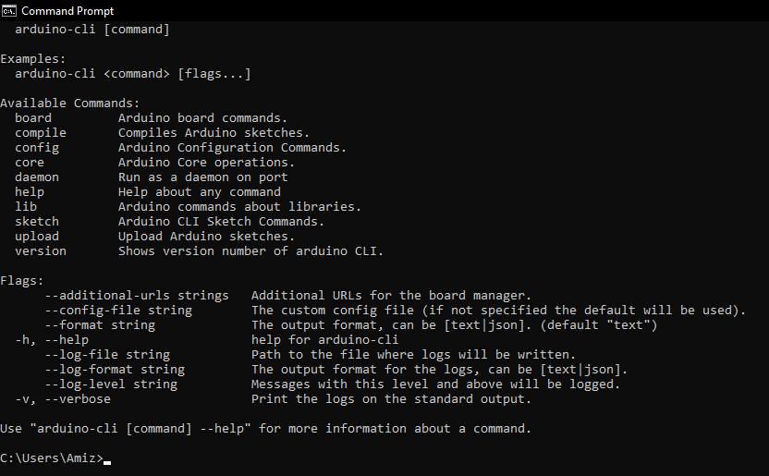
Arduino CLI (Command-Line Interface)
Follow the suggested solution
You can proceed to next steps

Slide 11
Arduino CLI (Command-Line Interface)
5) Right click on Arduino folder in your sandbox and choose the “open with code”. Alternatively, you can open Visual studio code application, open the Arduino folder by the following step:
“File -> Open Folder… -> <The location of Arduino folder in sandbox>”
You may download or copy the Arduino setup from my GitHub. Do remember that some of the setting may need to change such as in tasks.json.
"command": "arduino-cli upload -p COM8 -v --fqbn arduino:avr:uno ${fileBasenameNoExtension}",
Your Arduino board may not be the same COM port as mine which you need to change. By now you can test if Arduino can be upload from Visual Studio code. You keyboard shortcut will be the same as C programming such that:
“alt+f9” = compile code
“ctrl+f9” = upload code to Arduino board

Slide 12
Arduino CLI (Command-Line Interface)
Which ever method you choose to configure Arduino on your visual studio code shouldn’t be a problem. Amazingly, you have both methods installed on your visual studio code.
In my opinion, Arduino-CLI method is the best cause it exposes you to complicated way to install embedded software such that you can do the same method for installing boards such at STM.
On top of that, both method supports debugger. Remember that debugger is ONLY POSSIBLE if your board comes with a hardware debugger such as Jlink or J-ice.

Slide 13
Hooray! Good job!
You have successfully installed the necessary files for C programming. That’s not so hard right? Don’t worry about the installation for other programming language. It will be simple than this!
Do note that there will be setup needed (not necessary) to build and run C files. The reason for the setup is to make compiling and running C files fast and easy. The steps will be explain later when you compile and run the very first .c file (SimpleHelloWorld.c)

Slide 14







Feedback
Powered by
raceacademy.com.sg
enquiries@raceacademy.com.sg
RACE – Robotics Automation Centre of Excellence
RACE Robotics

